Slide 1
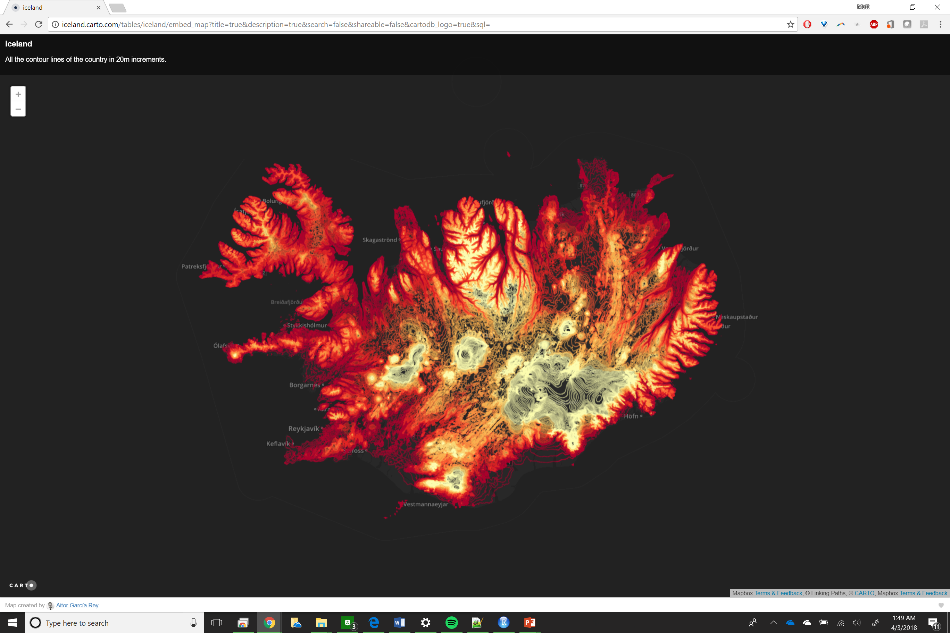
Notes:
http://iceland.carto.com/tables/iceland/embed_map?title=true&description=true&search=false&shareable=false&cartodb_logo=true&sql=

Slide 2
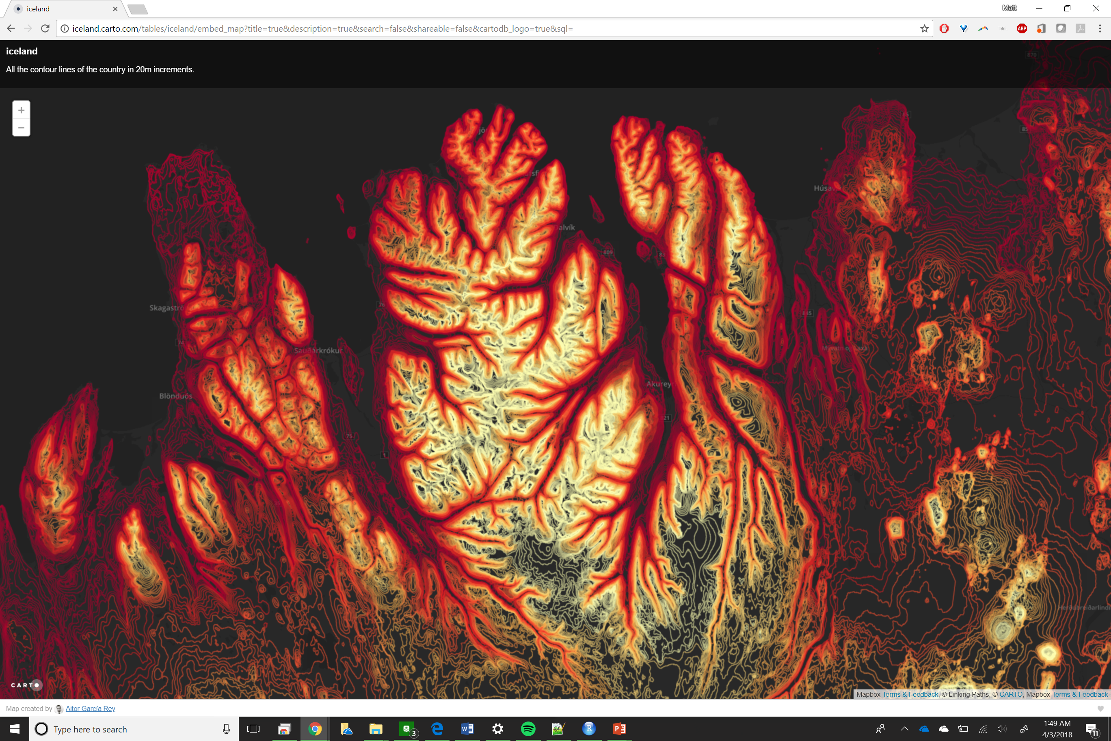

Slide 3
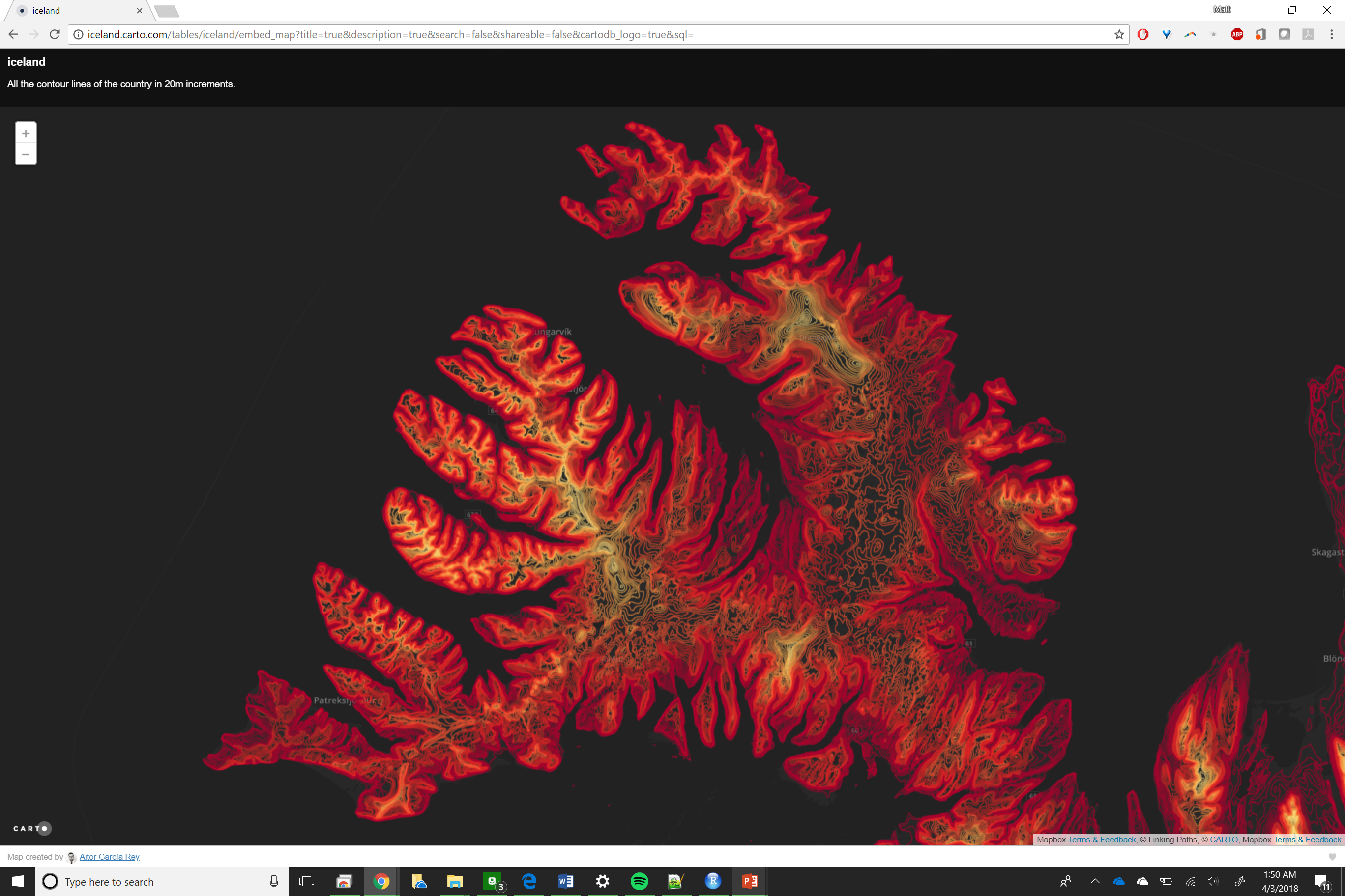

Slide 4
Robustness and Resistance
Robustness and resistance are two aspects of insensitivity to assumptions about the nature of a set of data.
Robust methods are not sensitive to particular assumptions about the overall nature of the data. A robust method is not necessarily optimal in any particular circumstance, but performs reasonably well in most circumstances.
Resistant methods are not unduly influenced by a small number of outliers, or error data values.

Slide 5
ArcGIS Interpolation methods
Deterministic
IDW (Inverse Distance Weighted)
Natural neighbor
Trend
Spline
Spline with Barriers
Geostatistical
Kriging
Methodological
Topo to Raster

Slide 6
Spatial Interpolation
The official ESRI definition of kriging is “an interpolation technique in which the surrounding measured values are weighted to derive a predicted value for an unmeasured location’.
This basically means that measured values help to interpolate or define values for those that are unknown.
Kriging is different from other spatial interpolation techniques because it is able to assess the quality of predicted values and thus, not all points need to be measured and/or known (Chang, 2012).

Slide 7
Interpolation and the First Law of Geography
Tobler’s First Law
“Everything is related to everything else, but near things are more closely related than distant things”
Interpolation: Determining unknown values from known measurements

Slide 8
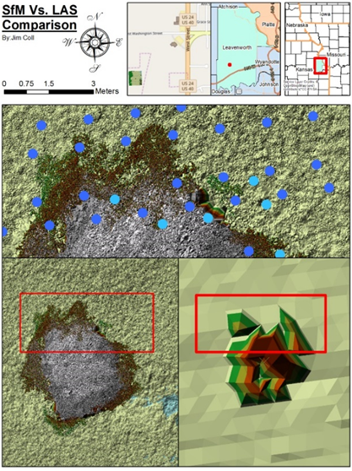
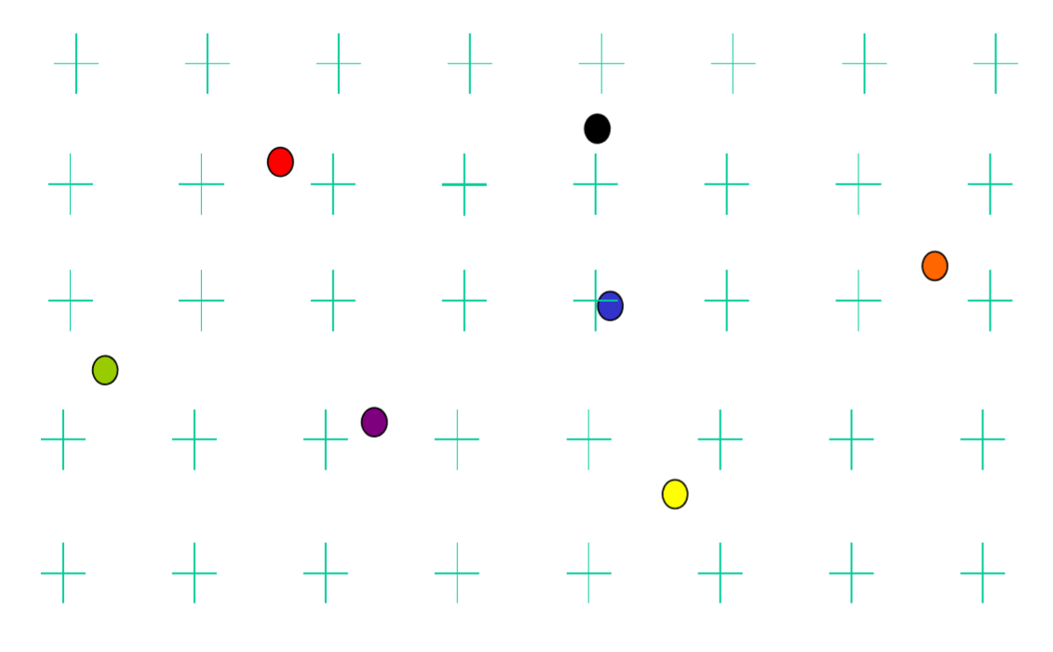

Slide 9
Global Interpolation Methods
Global interpolation
use all samples to estimate the value at an unsampled location
Data fitting using all the samples
Z=f(x,y)
Trend surface models (polynomial equations)
A first-order trend surface simply fit a 3D plane to all the sample points.
Z = b₀ + b₁x + b₂y
Higher order polynomial functions could fit more complex surfaces to sample points
Z = b₀ + b₁x + b₂y + b₃xy + b₄x²+ b₅y²
Other forms of the functions
Whether the surface passes the sample points

Slide 10
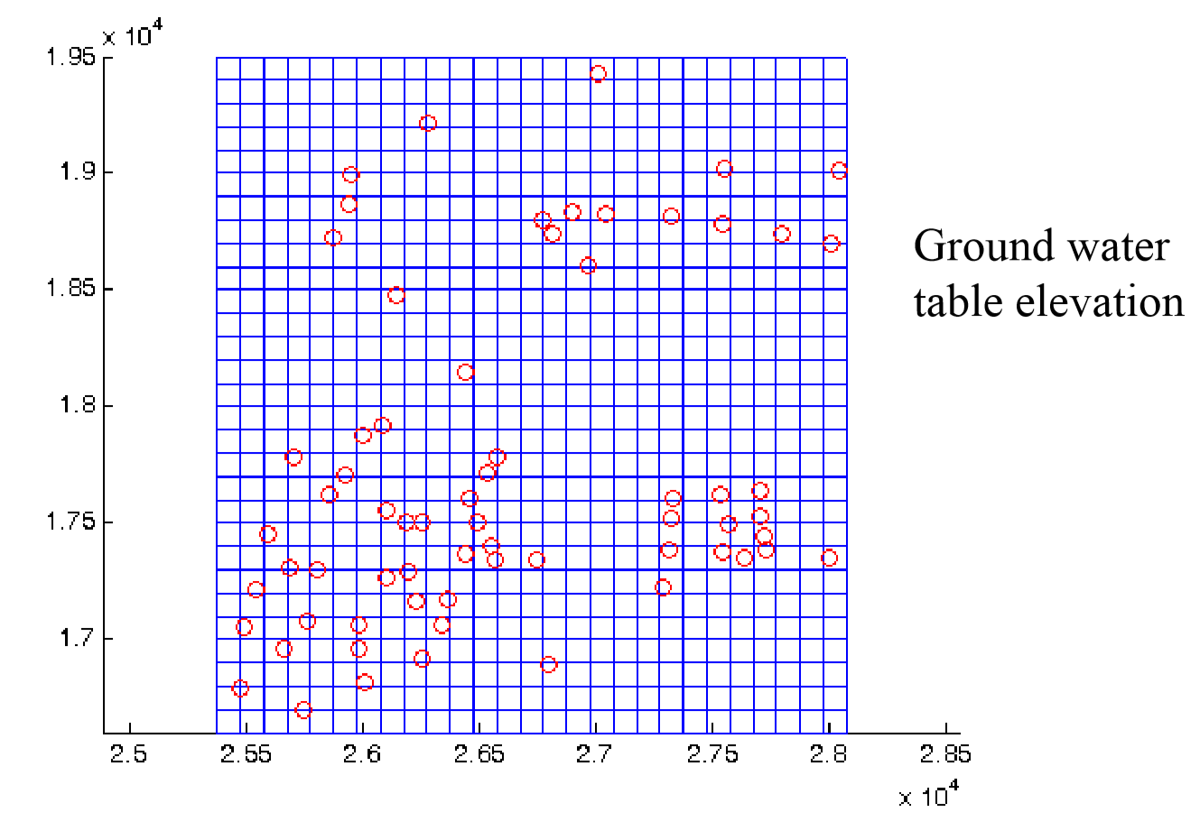

Slide 11
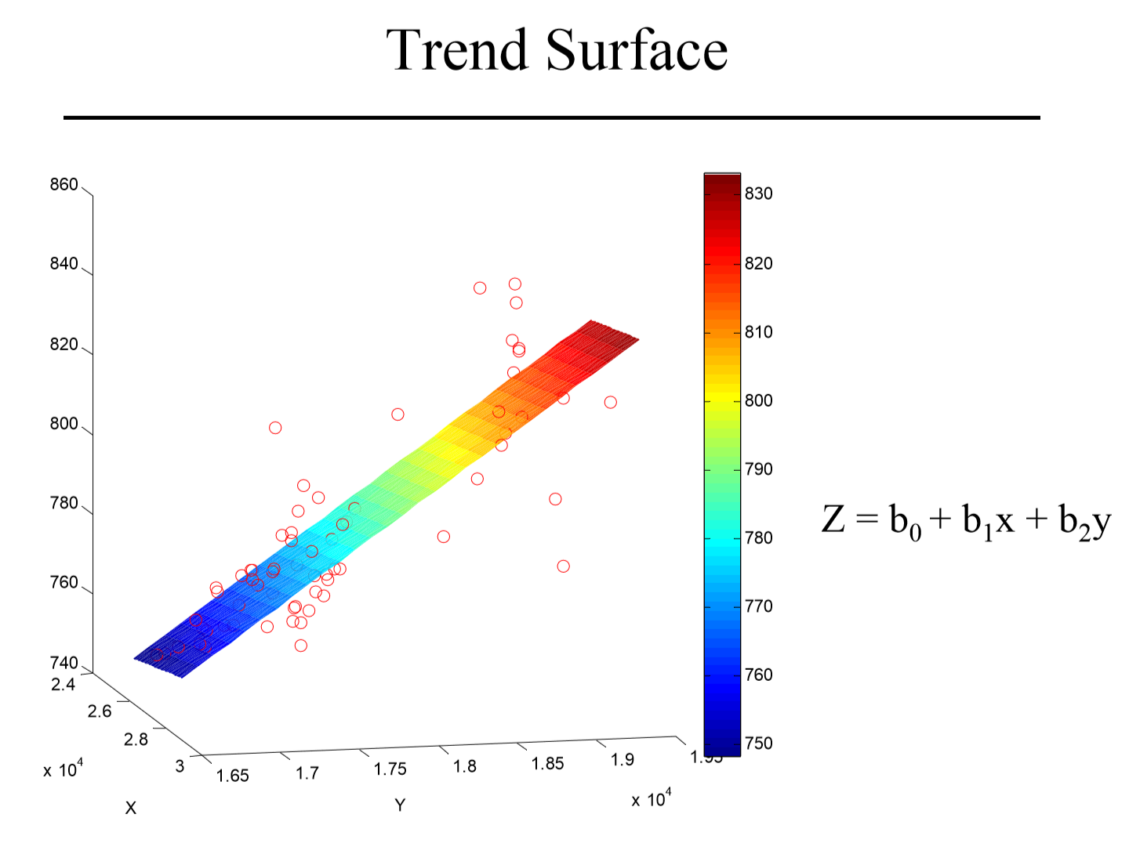

Slide 12
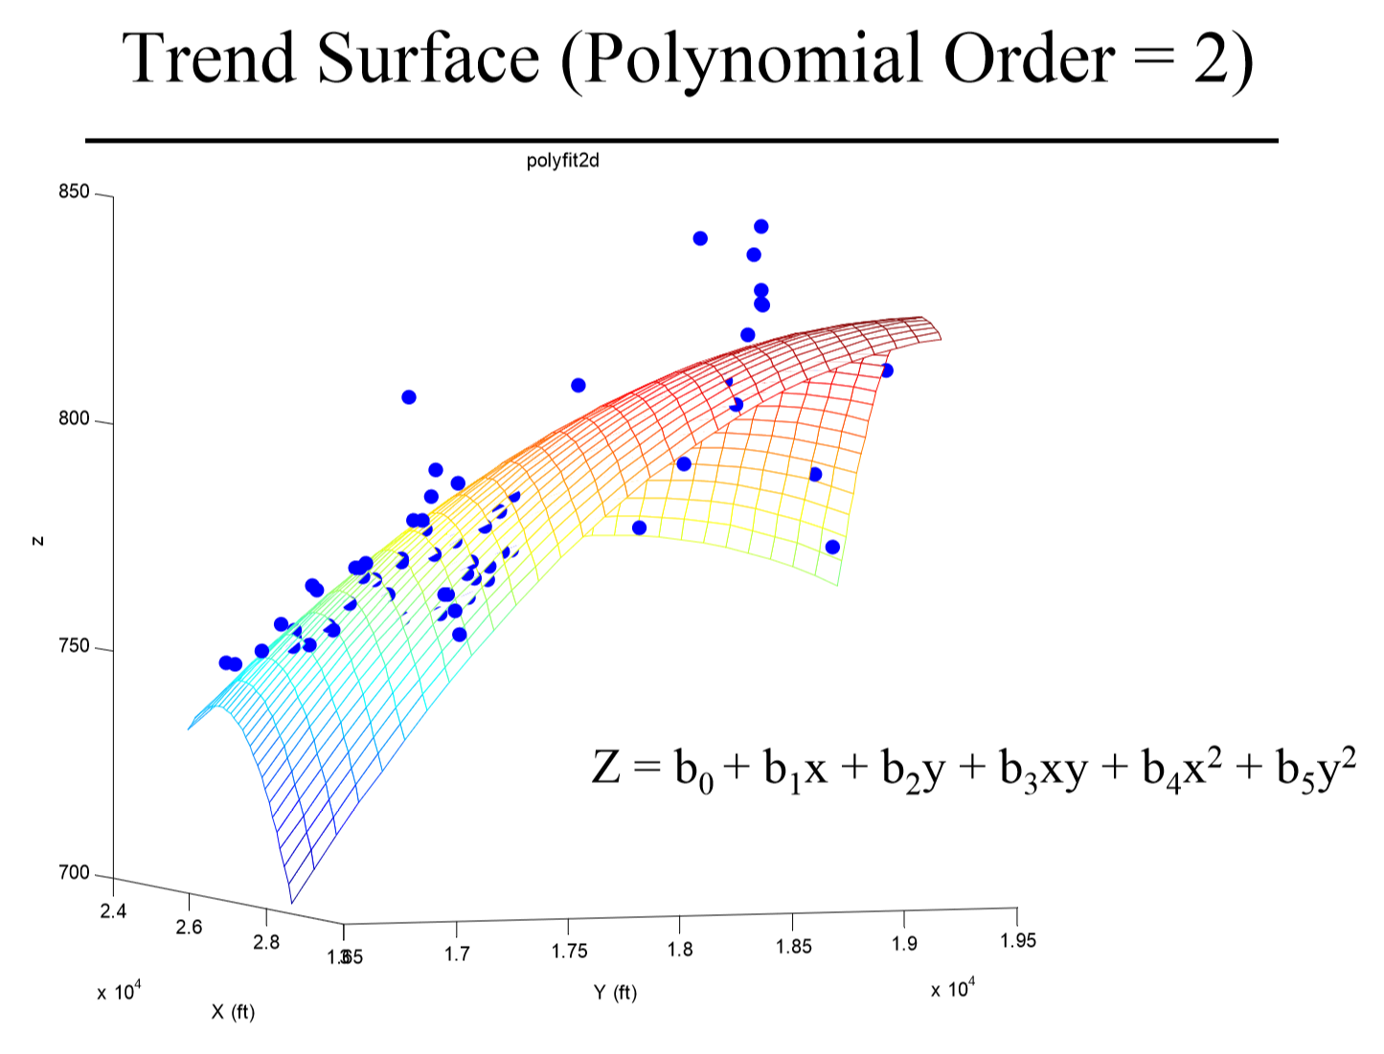

Slide 13
Local Interpolation Methods
Every thing is related to everything else. Near things are more related than distant things (First law of geography)
Local interpolation
use nearby samples to estimate at an unsampled location
Near things are more similar than distant things
How can the first law of geography be used in spatial interpolation
Using nearby samples
How near is “nearby”?
How to combine nearby values?
Simple local interpolation methods
Nearest neighbor results into Thiessen’s polygons
Inverse distance weighted (IDW)

Slide 14
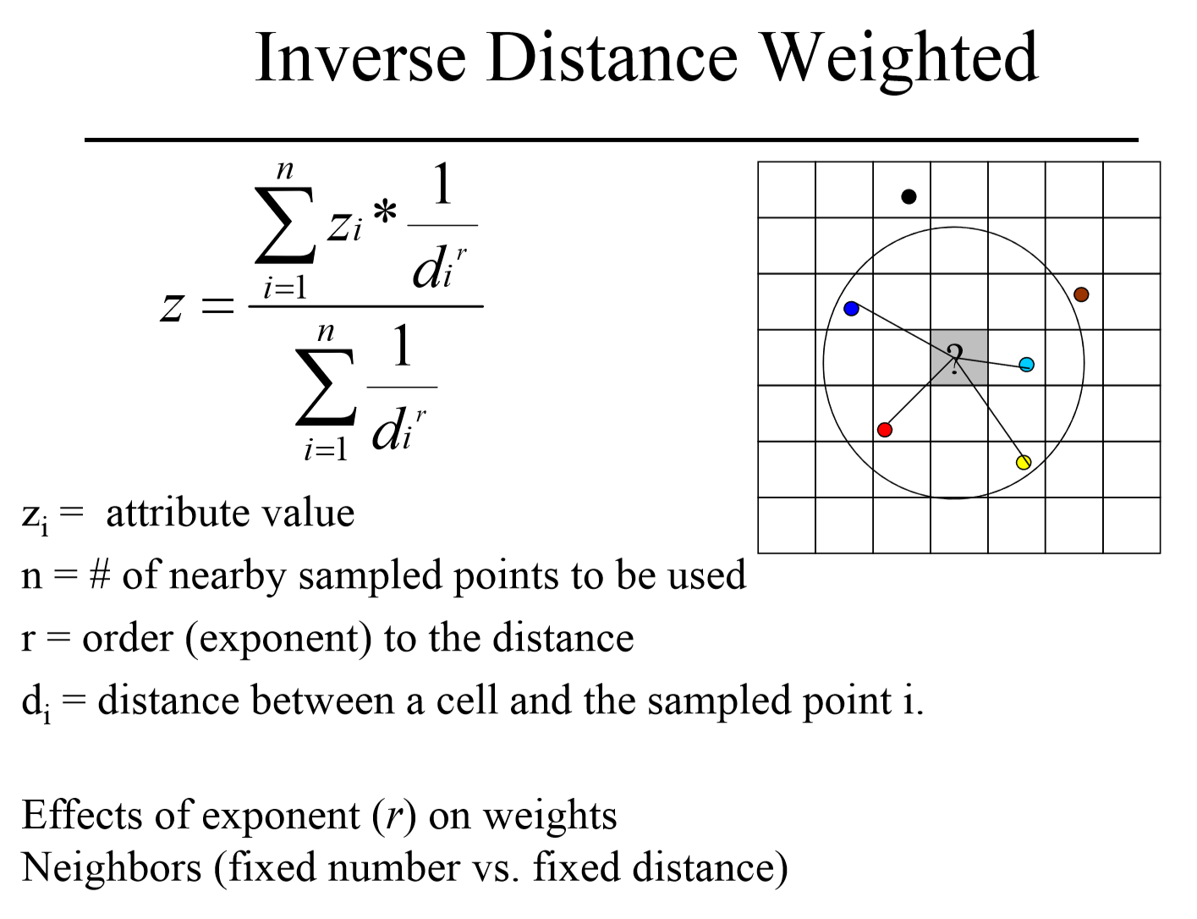
Notes:
https://www.youtube.com/watch?v=5oScAPFAVi0

Slide 15
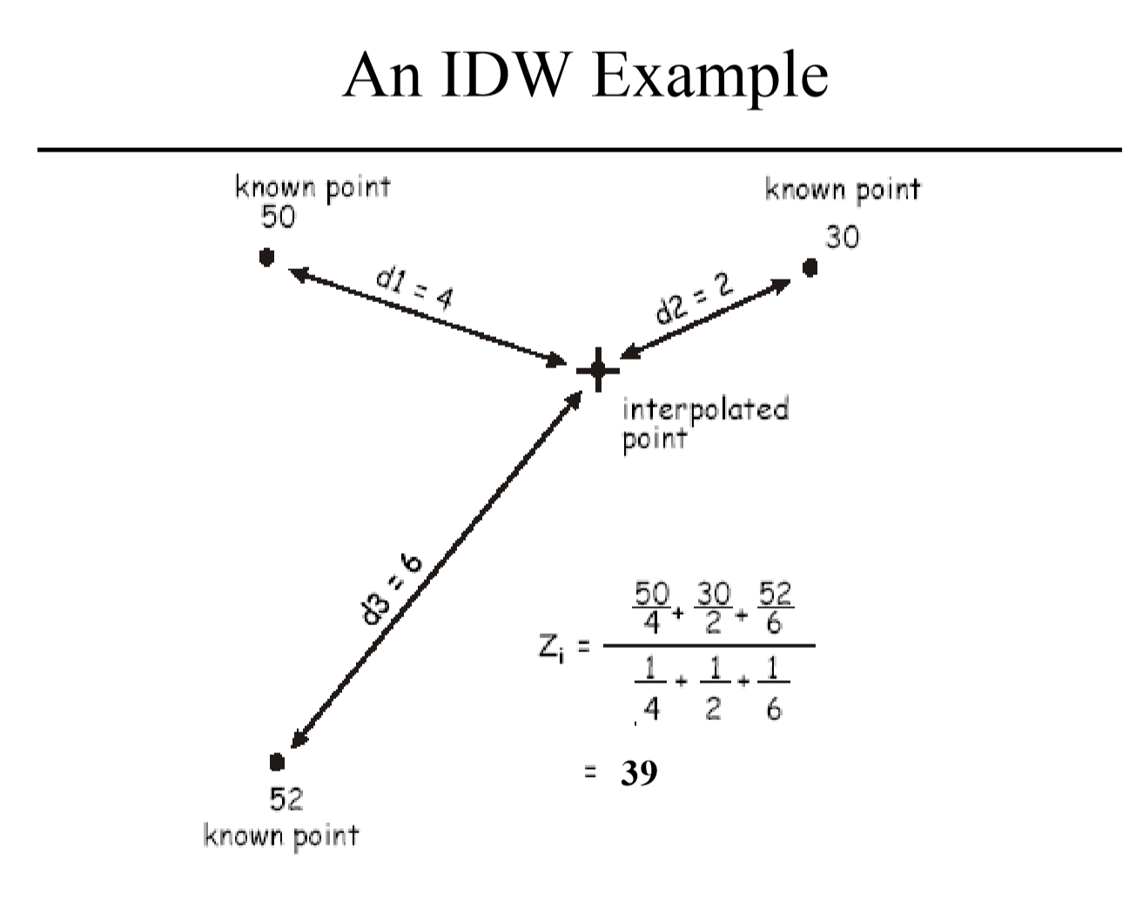

Slide 17
Notes:
https://www.youtube.com/watch?v=5oScAPFAVi0

Slide 18
How to Quantify the Similarity (or difference) in Space
Two locations close to each other are more likely to have similar values than two location that are far apart
spatial autocorrelation
How similar is a variable to itself in space?
Different variables have different (spatial) similarities
Same variable may have different similarity in different direction (anisotropy)
How to quantify (or model) the spatial similarity (or difference)?

Slide 19
Statistical interpolation
Unlike it’s deterministic counterparts, Kriging considers the spatial relationships of the measured points.
This means that we can not only say what a value is at a given point, but also how certain we are of that prediction.
Kriging assumes that the distance or direction between sample points reflects a spatial correlation that can be used to explain variation in the surface. The Kriging tool fits a mathematical function to a specified number of points, or all points within a specified radius, to determine the output value for each location.

Slide 20
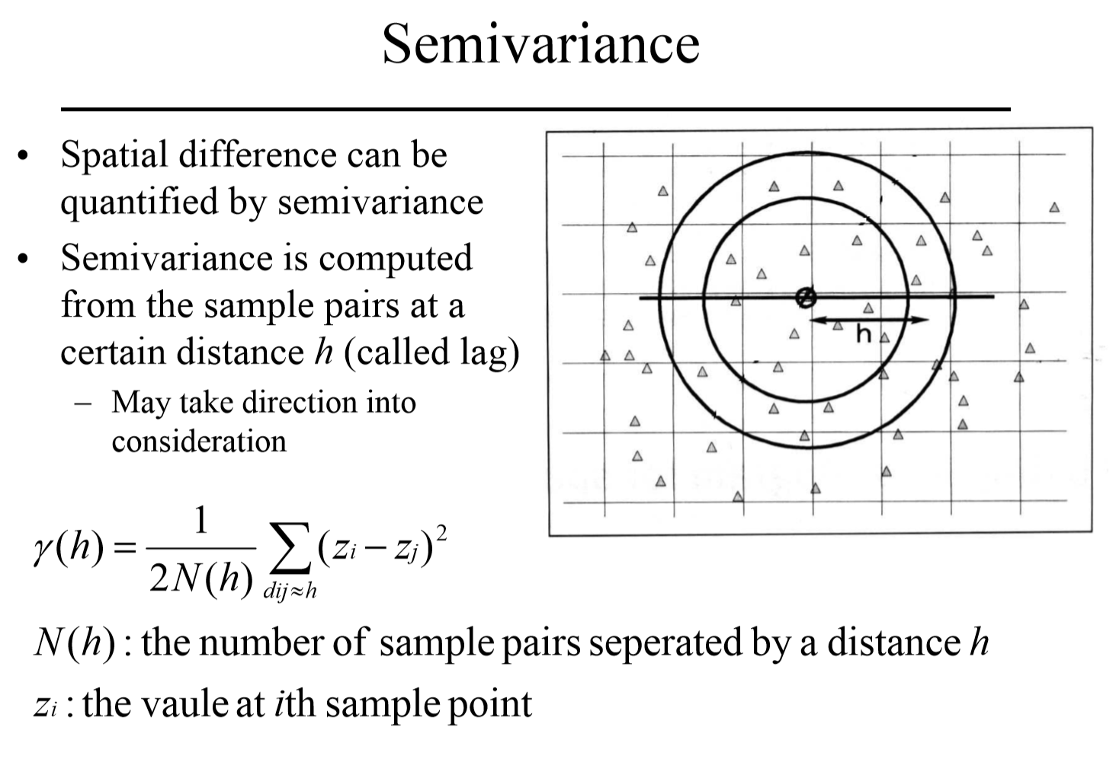

Slide 21
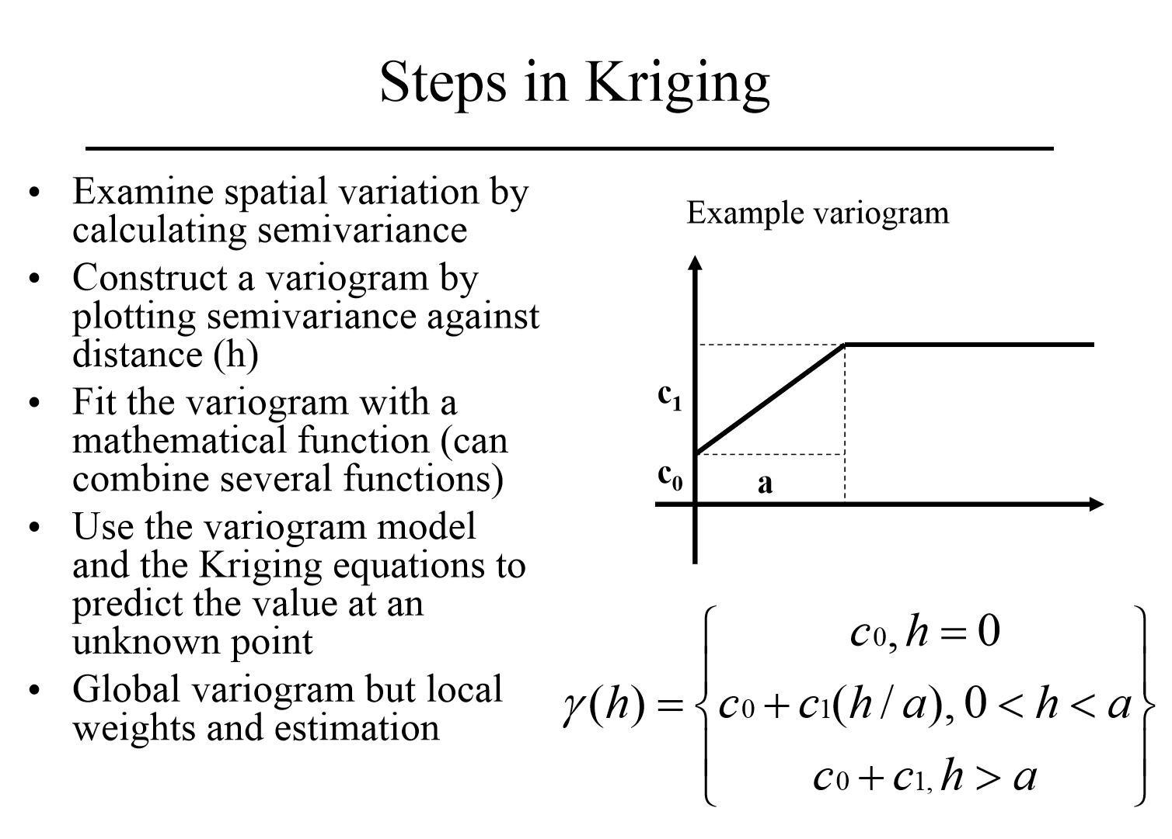

Slide 22
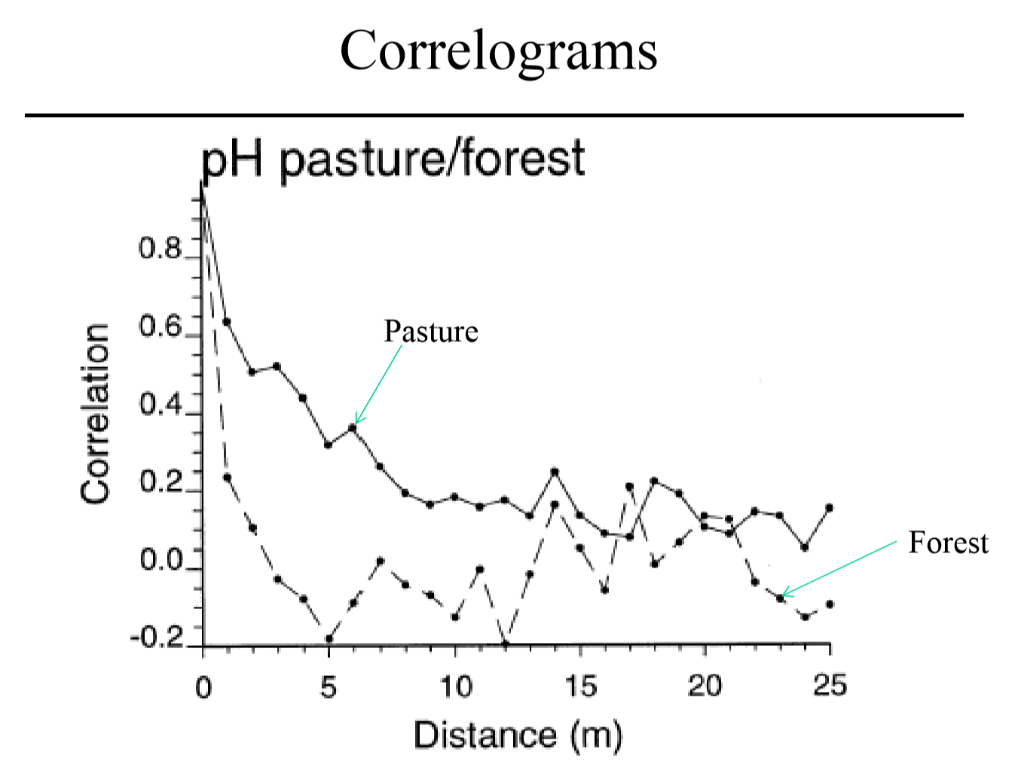

Slide 23
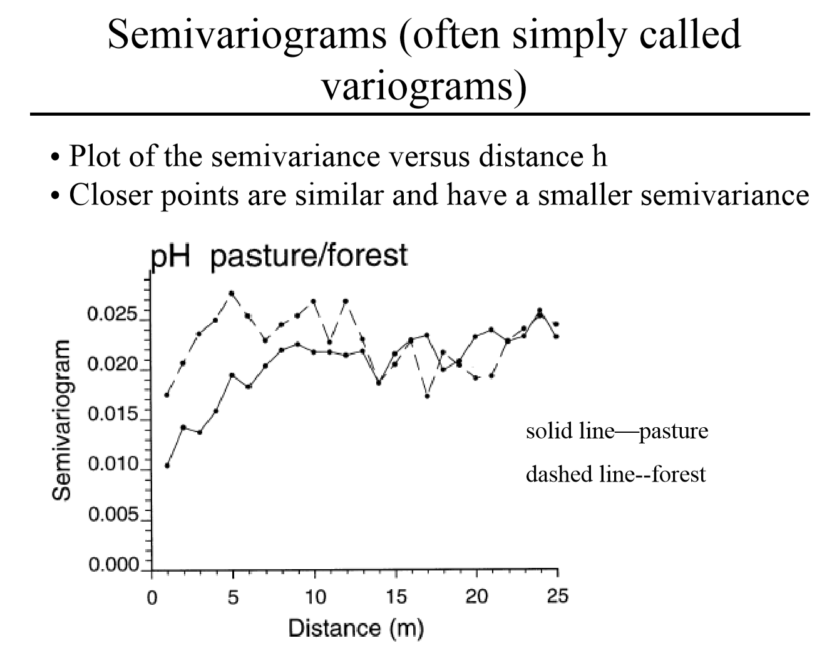

Slide 24
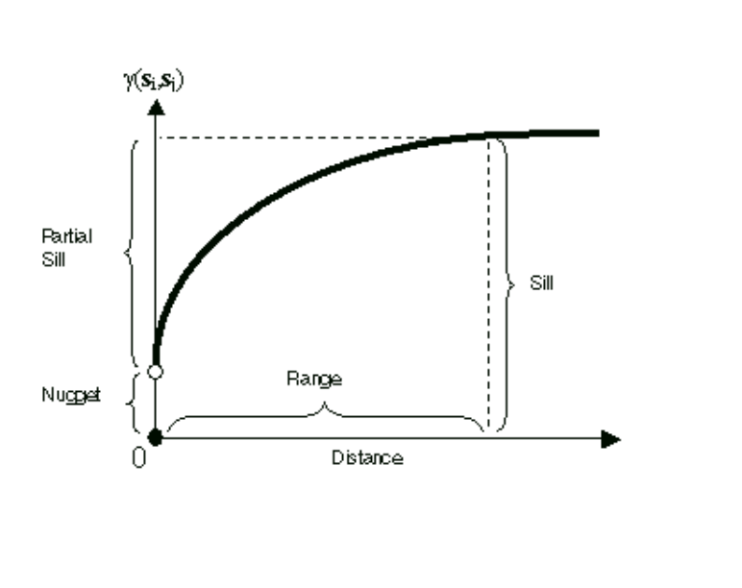

Slide 25
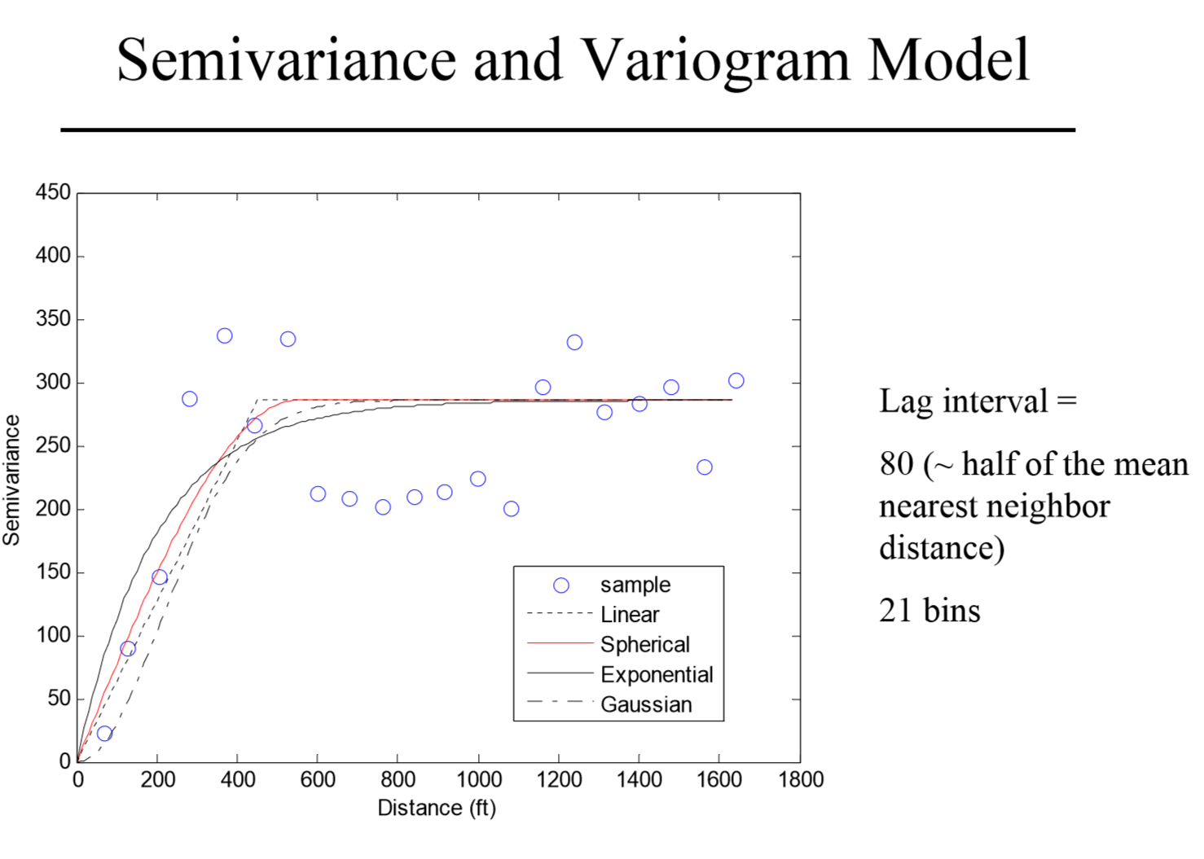

Slide 26
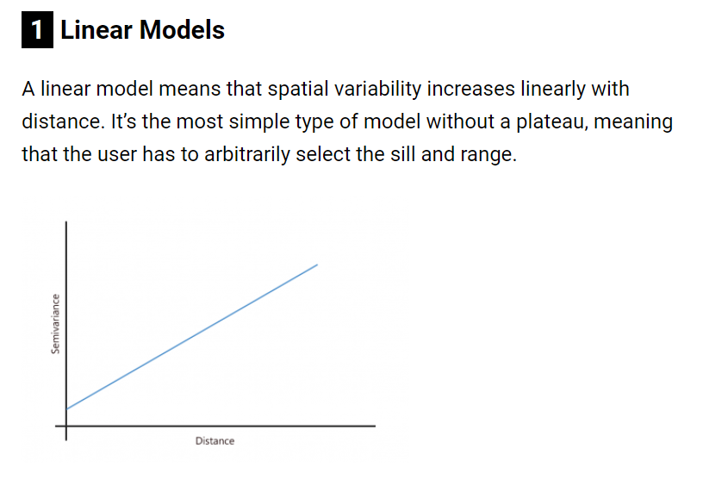
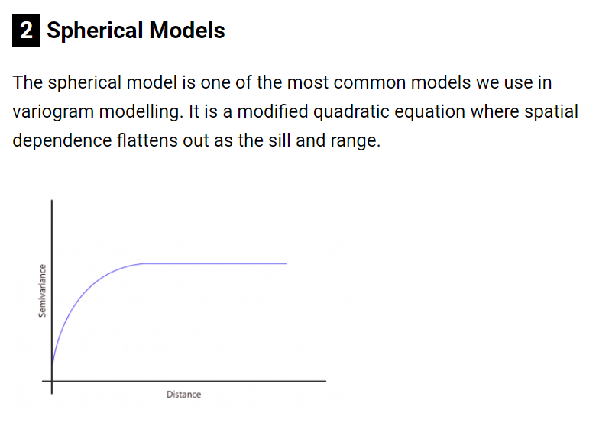
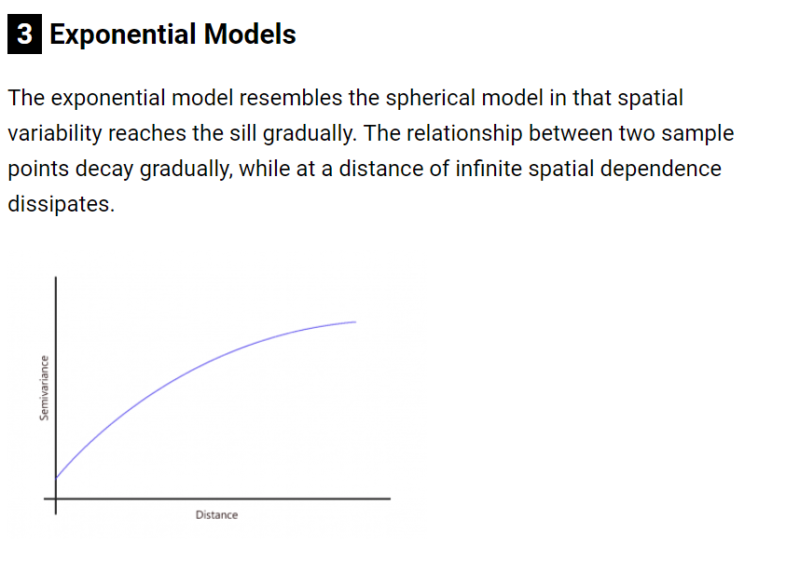
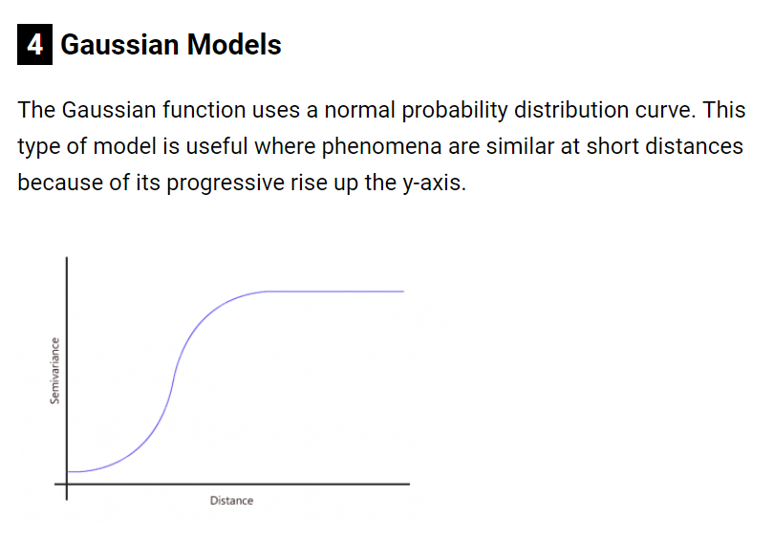

Slide 27
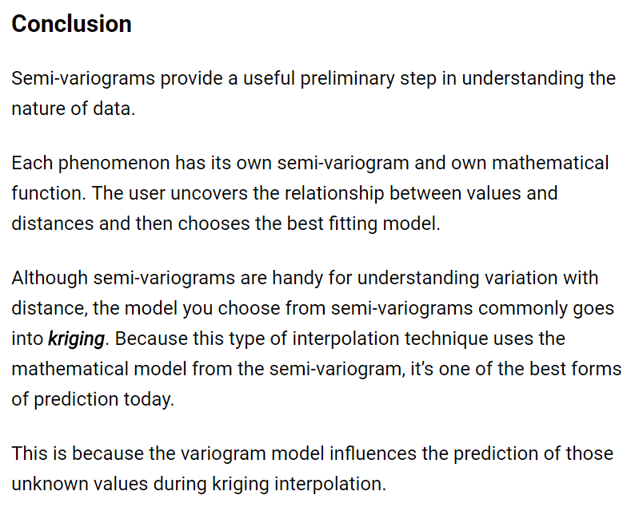
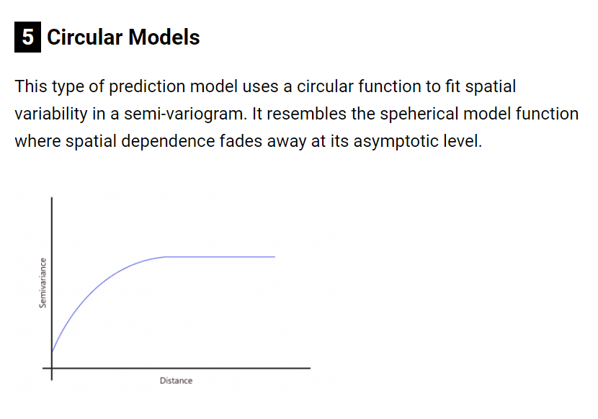

Slide 28
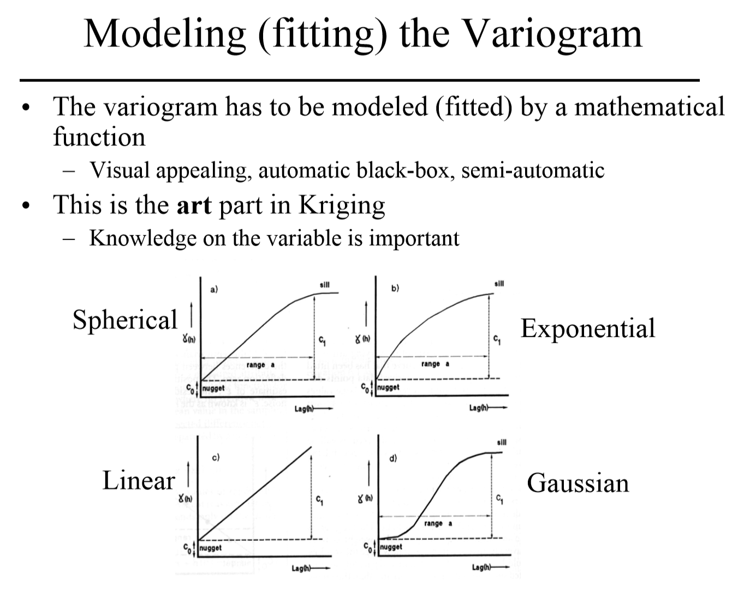

Slide 29
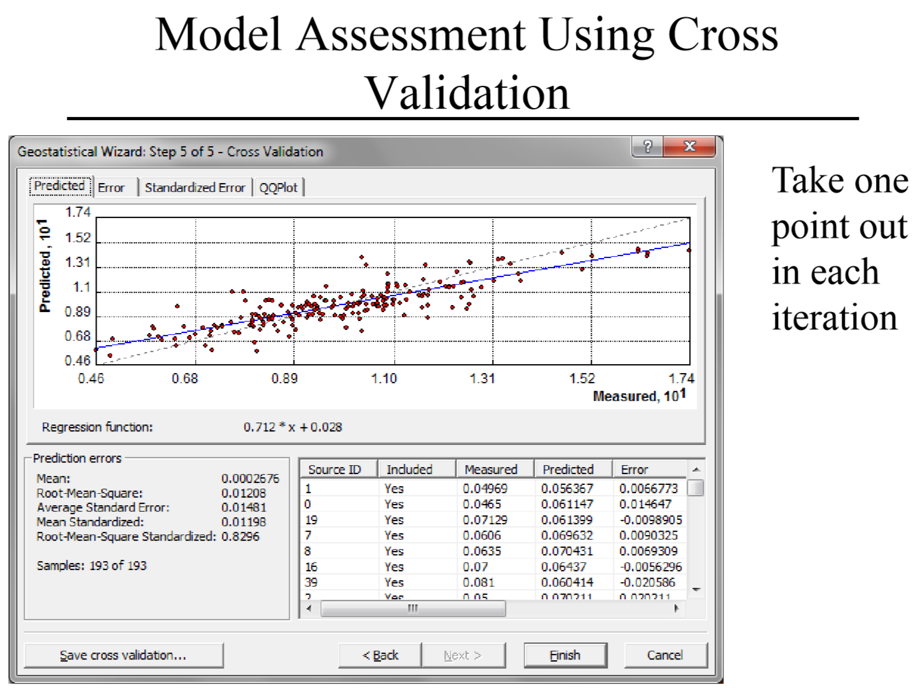

Slide 30

But what is a Correlogram?
How do I get a Semi-Variogram?
Why?

Slide 31
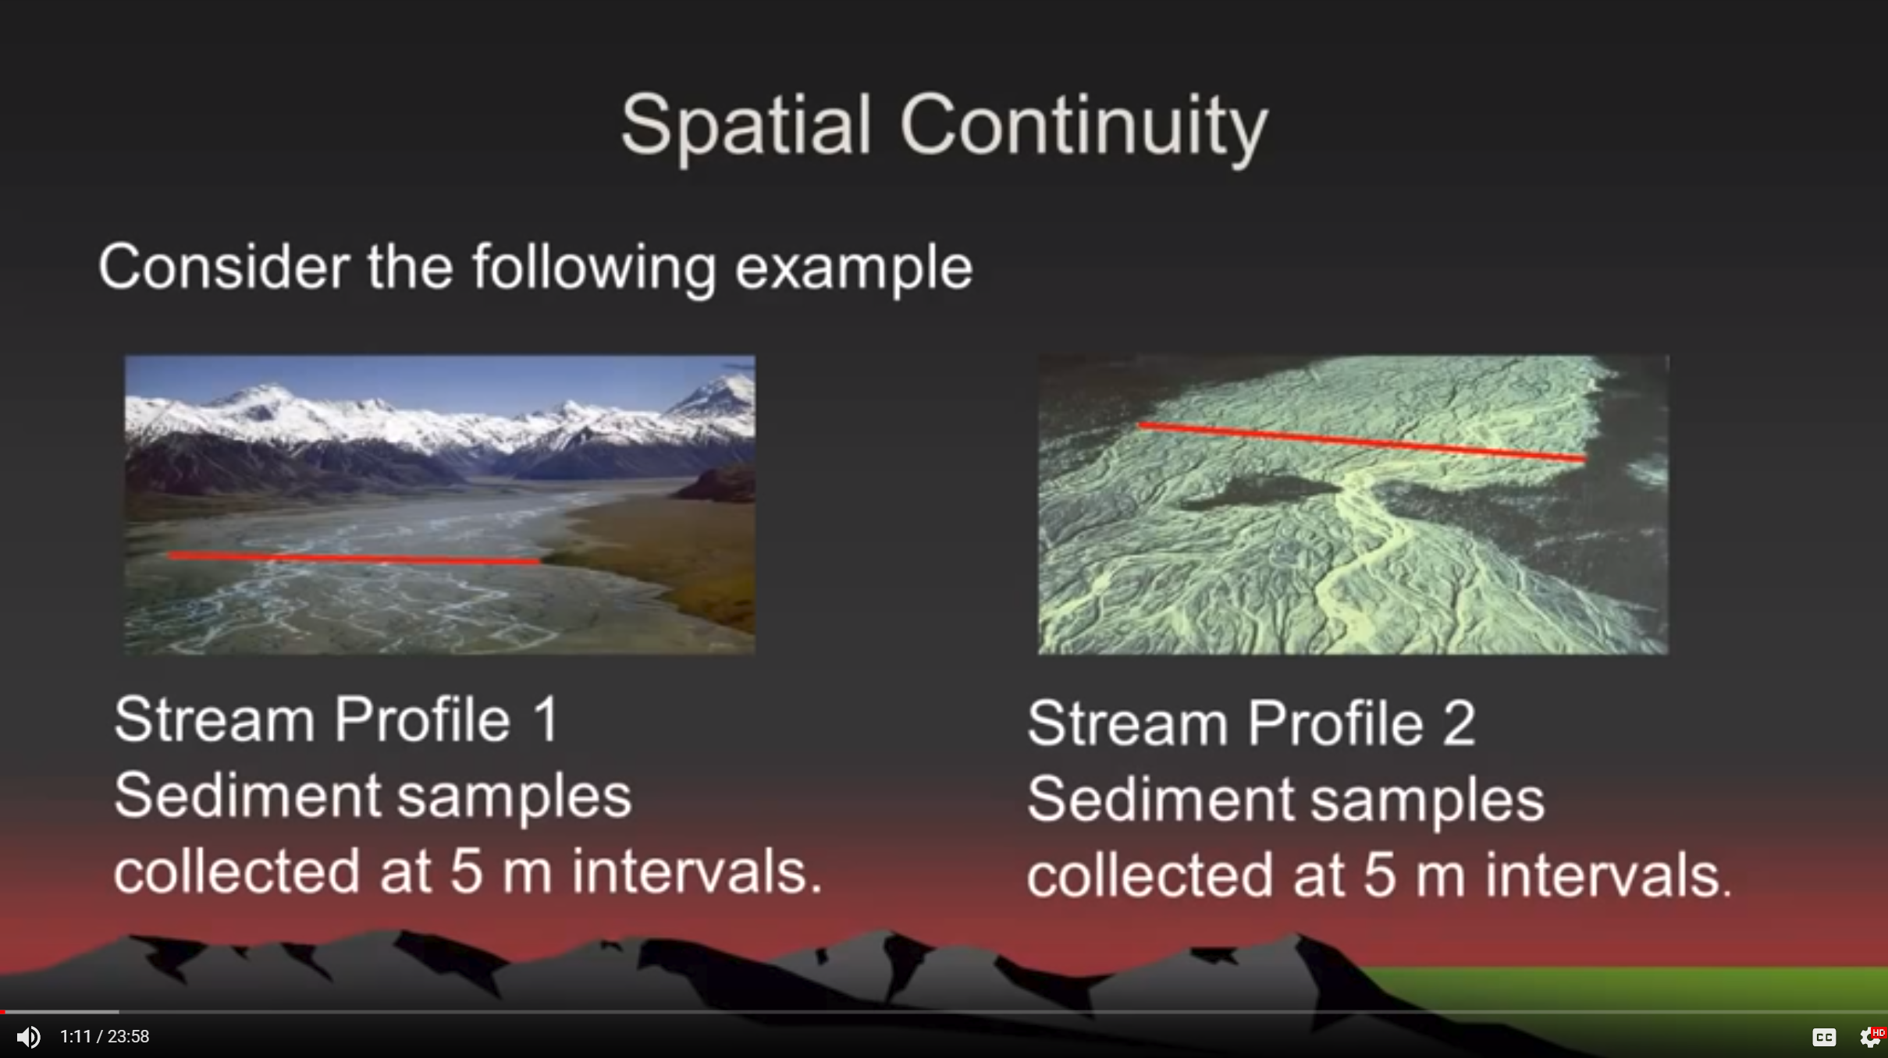
Notes:
https://www.youtube.com/watch?v=SJLDlasDLEU

